Slide 1
User Tracking System Based on RFID Signal Proposal
NCTU NSS 2018
Chengfa Huang
Willy Cheng-Fa Huang
2018.08.09 @NCTU EC-345

Slide 2
Outline
Motivation
Environment Statement
Challenge

Slide 3
Motivation

Slide 4

Notes:
超市 排隊

Slide 5
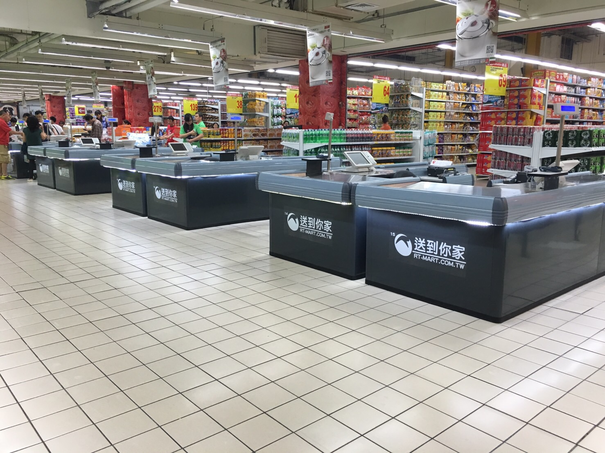
Notes:
自己結帳超市

Slide 6
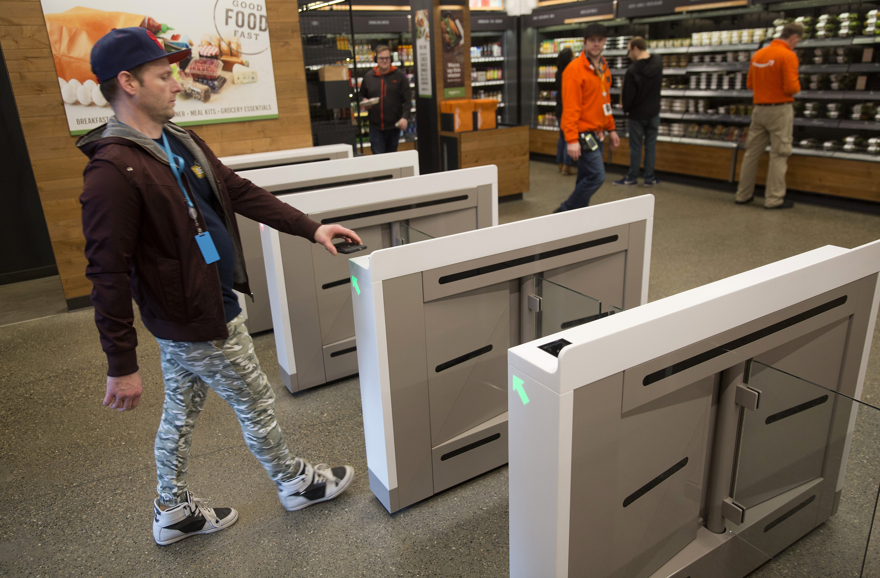

Notes:
超市 排隊

Slide 7
Unmanned Store
Store entrance
Human recognition
Region cross over
Stuff pick
Money pay

Slide 8
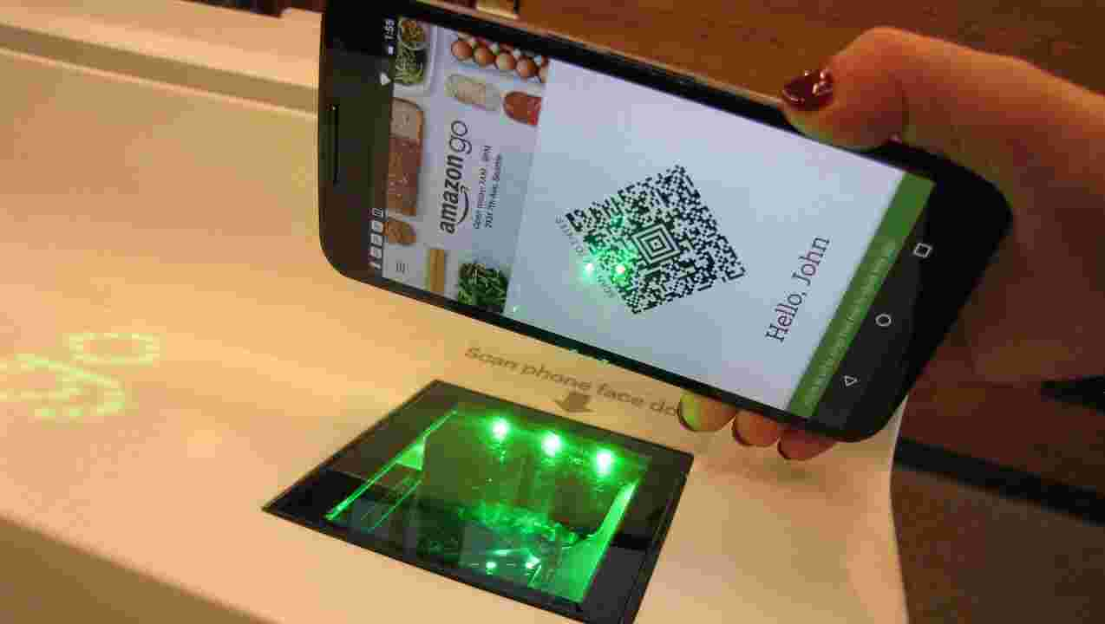

Slide 9
User Info.
Scanner

Slide 10

Wristband
Recognition

Slide 11
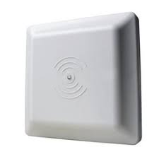
R4
R2
R3
R1

Slide 12
R4
R2
R3
z
R1

Slide 13


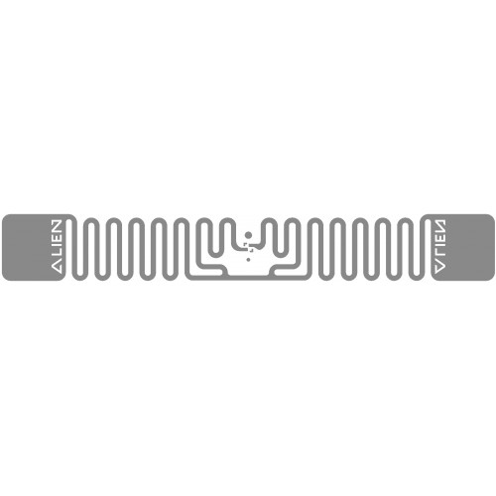
Bottle with tag
Wrist with tag

Slide 14
Checkout

Slide 15
System Inspiration
Region Localization
UHF RFID tag
NLOS
Light weight
Multiple reading
Easy tracking

Slide 16
Environment Statement

Slide 17
Region
Implementation
Place
Super market
Shopping mall
Convenient store
Definition
What is region
水果
生活用品
食物
冰…

Slide 18
RFID Setting
Passive tag
Object tag
Wrist tag
Reader
每個 region
Data base 建立

Slide 19
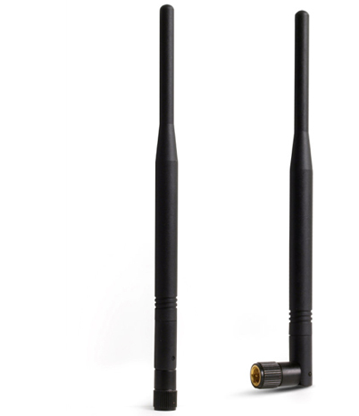
RFID Setting

Slide 20
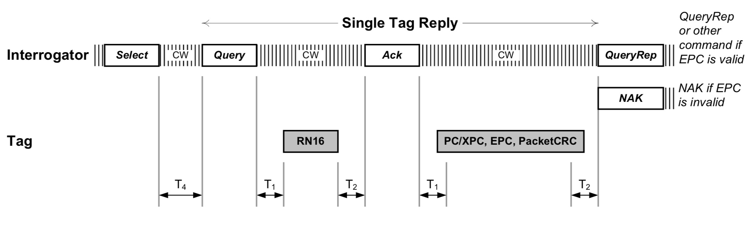


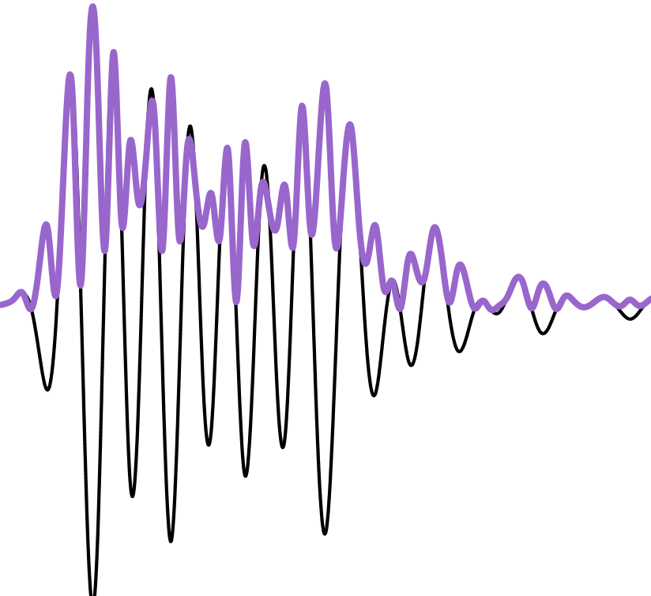
Backscatter
Carrier Wave
Power
Notes:
The reader transmits a continuous RF wave (CW) which assures that
the tag remains powered

Slide 21
Challenge

Slide 22
Problem
how to detect the subregion: Detect for the signal variation in each region
how to detect unknown tag: when we found the signal variation, asking for the ID and start tracking it.
how to match tag-object: pair the tags

Slide 23
Reference
https://www.flaticon.com/
https://www.sitebuilderreport.com/stock-up

